Slide 1
Enterprise Risk Management
2019 Massachusetts Trustees Conference | March 28, 2019

Slide 2
Panel Introductions
Amanda Robbins: CSVP Advisor, Department of Higher Education
Patricia Gentile: President, North Shore Community College
Kevin Foley: Board of Trustees, Framingham State
Linda Snyder: Board of Trustees, MassArt

Slide 3
Summary of Presentation
Introductions
Overview of Enterprise Risk Management (ERM)
Panel Discussion
Questions & Answers

Slide 4
Enterprise Risk Management
A practical definition of ERM from Risk Management: An Accountability Guide for University and College Boards (AGB Press, 2013):
ERM is a business process led by senior leadership that extends the concepts of risk management and includes:
Identifying risks across the entire enterprise
Assessing the impact of risks to the operations and mission
Developing and practicing response or mitigation plans
Monitoring the identified risks, holding the risk owner accountable, and consistently scanning for emerging risks

Slide 5
Risk Management Process
Operational Analysis
Vulnerability Assessment
Risk
Reduction Solutions
Implementation
Plan

Slide 6
Operational Analysis
Identify Assets:
People
Physical Property
Reputation
Intellectual Property
Proprietary Information

Slide 7
Vulnerability
Assessment
Understanding Risk:
Identify the threats and hazards that may affect your organization
Determine the likelihood of occurrence and impact if a threat or hazard were to occur
Evaluate current countermeasures in place to mitigate risk

Slide 8
Risks Impacting Higher Education
Traditional Operational Risk
  weather, active threats, fire, strike, accident
Legal and Regulatory Risk
  litigation by staff and/or students
Financial Risk
  drop in enrollment, decline in govt support, failed fundraising
Political and Reputational Risk
  loss of accreditation, govt sanctions, negative PR

Slide 9
Risk Reduction Solutions
Based on the results of the operational analysis and vulnerability assessment, identify gaps and vulnerabilities
Apply industry standards and best practices to develop risk reduction solutions to close gaps
Focus on prevention, protection, mitigation, response, recovery
Include physical, procedural, staffing, training, redundancy and technological risk reduction solutions

Slide 10
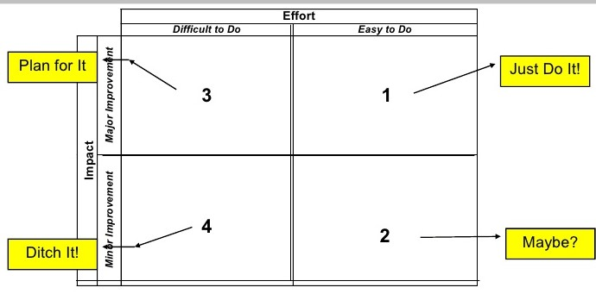
Implementation Plan
Phased implementation plans/timeline ~ Budget analysis and ROM pricing

Slide 11
Strategic Risk Management Plan
1-5 year Risk Management Master Plan
Based on real-life vulnerabilities and risk based solutions
Associated costs included
Priorities weighed and set in a comprehensive and clear manner
Easy to understand and justify to leadership
Since it is a multi-year plan, performance metrics are essentially already built in
Revisit your plan annually or every 2 years to adjust as needed and to show progress

Slide 12
Addressing Risk at Institutions in MA
Higher Education is different: Campus safety and violence prevention demands must be balanced with the overall philosophy of institutions of higher education. Campuses are quite different from airports or federal buildings. Their openness makes them, inevitably, soft targets but for all the right reasons: a desire to remain open to a wide variety of individuals, ideas, and even disagreements. Any safety and security apparatus must focus on minimizing risks and maximizing defenses to protect the community, but must also maintain the special status these institutions have in our society.
Governance is key: The necessity of providing safe and secure environments goes well beyond tactical or procedural requirements. A number of the report’s recommendations focus instead on providing guidance on the best governance structures at the system, segmental, and institutional level that can provide coordinated approaches to protect the wellness of our communities.
Ownership must be shared: The “silos” that exist between those charged with campus safety and violence prevention – either traditional law enforcement or staff involved with sexual violence complaints – and the leadership structures of each institution continue to persist. Safety and security, to be effective, must be “owned” by the entire community.
Engagement and support from the institution’s leadership: Some of the most successful initiatives and programs at the institutions visited were incorporated into the school’s overall strategic plan for campus safety and violence prevention. Being elevated to this level was a direct result of an Administration and/or Board of Trustees that fully support and/or have an active role in guiding these efforts. Too often it is sidelined from the core planning; it must be elevated and recognized as a shared responsibility.

Slide 13
Current State of Enterprise
Risk Management
Sample of AGB/UE Survey Results:
In 2013, 45% of respondents “strongly agreed” that ERM is a priority at their institution compared to 2008 (41% “mostly agreed”)
  But, in many cases, institutions are not following any formal risk assessment processes - 39% of respondents say their institution has conducted an ERM process in the last 2 years (61% have not)
62% of respondents in 2013 report that the full board is engaged in risk discussions (up from 47% in 2008) and discussions are occurring across a greater number of board committees
  However, 60% of respondents reported that the risk information boards receive—particularly about financial risks—is adequate, only 39% strongly agreed that enough risk information is shared to fulfill their legal and fiduciary duties
*A Wake-up Call: Enterprise Risk Management at Colleges and Universities Today. A Survey by the Association of Governing Boards of Universities and Colleges and United Educators

Slide 14
Trustee Engagement:
2016 Task Force Recommendations
Finding: Strategic Planning Process at the Institution Level
Campus safety and violence prevention should be incorporated into each institution’s strategic planning process.
Engagement at the institution level should include buy-in and commitment from the Board of Trustees as well as Senior Leadership. Too often it is sidelined from the core planning; it must be elevated and recognized as a shared responsibility.
Recommendation: Elevate Board of Trustees Engagement
The Board of Trustees for each institution carries a level of responsibility for managing and mitigating risks, as an important part of their overall fiduciary duty. Trustees need to be engaged in some level of oversight through the higher level strategic planning process to help make critical decisions related to initiatives and budget priorities.
To this end, Trustees are encouraged to form campus safety and violence prevention committees, and receive regular updates on applicable issues, to enhance accountability for the quality of campus life at all levels of the institution.

Slide 15
Board Responsibility:
AGB Recommendations
The Board’s responsibility for risk management has four components:
Establishing ERM as an institutional priority
Considering the institution’s tolerance for risk
Calling on senior administrators to establish a process for identifying, prioritizing and monitoring risk, with formal assignment of responsibility for risk assessment and management to an appropriate individual or office
Monitoring the plan’s implementation through regular, formal reporting to the board or an appropriate board committee by the appropriate senior administrator.

Slide 16
Panel Discussion
Panelists:
Patricia Gentile, President, North Shore Community College
Kevin Foley, Board of Trustees, Framingham State
Linda Snyder, Board of Trustees, MassArt
Questions for the audience to consider:
How frequently is institutional risk discussed at board meetings?
What are the key risks facing your institution?
How often are risk management plans updated and presented to the board?
If your campus conducts/has conducted campus climate surveys, how does the data obtained affect the risk management process?

Slide 17
Questions and Conference Survey
Amanda Botelho Robbins
Advisor, Campus Safety and Violence Prevention
MA Dept of Higher Education
arobbins@dhe.mass.edu
Please fill out the conference survey:
https://www.surveymonkey.com/r/2019Trustees

